Slide 1






Online Retail
Shipping Analysis
Presented by: Nor H

Slide 2


BUSINESS UNDERSTANDING
DATA UNDERSTANDING
TABLE OF CONTENT
DATA PREPARATION
ANALYSIS
CONCLUSION
RECOMMENDATION

Slide 3

BUSINESS UNDERSTANDING
INTRODUCTION
In the era of online commerce, the delivery of goods is an important factor in the development of the industry. Companies engaged in Online Retail Shipping compete to be the fastest and most affordable by considering customer satisfaction as a parameter of success. Therefore, the company wants to evaluate the rating given by consumers every time they make a purchase to measure the level of customer satisfaction.
STAKEHOLDERS
Production team, Executive

Slide 4


BUSINESS UNDERSTANDING
BUSINESS PROBLEM
The company wants to increase the rating given by consumers every time they make a purchase.
BUSINESS GOALS
Improve customer satisfaction and efficiency in the delivery of goods.
BUSINESS TASK
Analyze customer ratings of services provided and identify trends or patterns that need to be improved.

Slide 5
DATA UNDERSTANDING
DATASET OVERVIEW
DATA COLLECTION
The raw data consists of one CSV file, representing customer transaction data for an Online Retail Shipping company.
The total size of the raw data is 1.123 megabytes.
The raw data consists of 10999 rows and 12 columns.
DATA SCOPE
Using historical data of consumer transactions at Online Retail Shipping companiesce
RAW DATA COMPOSITION
Nominal: ID, Warehouse_Block, Mode_of_Shipment, Gender, Reached.on.Time_Y.N
Ordinal: Customer_rating, Product_importance
Discrete: Customer_care_calls, Cost_of_the_Product, Prior_purchases, Discount_offered
Contiunous: Weight_in_gms
DATA SOURCE
Raw data has been provided in Website kaggle

Slide 6

DATA PREPARATION
Check & Handling Outliers
Import CSV to Pandas DataFrame
Check & Handling Duplicated Data
Create additional columns
Adjust data types
Check & Handling Missing Values

Slide 7


Data Analysis

Slide 8

Percentage of Customer Satisfaction
Insight:
Neutral or dissatisfied consumers accounted for 60.4% of the 10999 consumers, 6,639 of whom were neutral or dissatisfied.
Satisfied
39.6%
Neutral or Dissatisfied
60.4%
Notes:
A lot of data: 10999
Satisfied: 4360
Dissatisfied/Neutral : 6.639

Slide 9


Consumer Satisfaction Based on Gender
Neutral or Dissatisfied
Satisfied
3.354 (30,49%)
Insight:
There is no significant percentage difference in customer satisfaction between genders. Both females and males experience high levels of dissatisfaction.
Female
2.191 (19,92%)
3.285 (29,87%)
Male
2.169 (19,72%)
0
1.000
2.000
3.000
4.000
Notes:
By Gender
Female
P : 2.191 (19,92%)
TP: 3.354 (30,49%)
Male
P: 2.169 (19,72%)
TP: 3.285 (29,87%)

Slide 10
Consumer Satisfaction Based on Discount
Neutral or Dissatisfied
Satisfied
0-3 (Low)
Insight:
The graph shows the distribution of discounts and customer satisfaction. Although products with high discounts attracted 3,103 consumers, the satisfaction level of this group was low.
4-7 (Medium)
> 7 (High)
0
1.000
2.000
3.000
4.000
Notes:
By Discount
Low
P : 984 (8,95%)
TP : 1.538 (13,98%)
Medium
P : 1.326 (12,06%)
TP : 1.998 (18,17)
High
P : 2.050 (18,64%)
TP : 3.103 (28,21%)

Slide 11
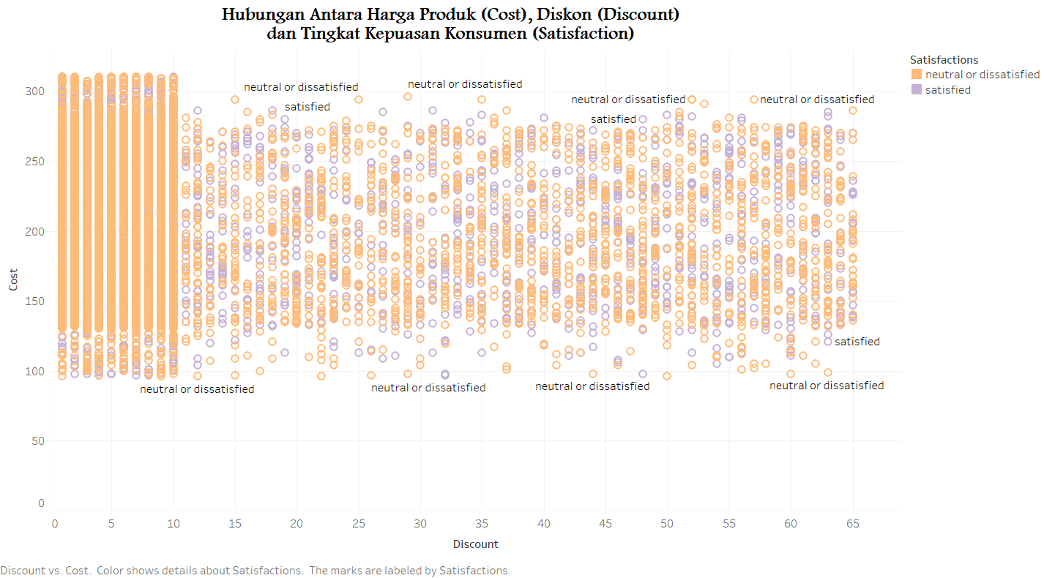
RELATIONSHIP BETWEEN PRODUCT PRICE, DISCOUNT AND CUSTOMER SATISFACTION
Insight:
From the scatter plot between product price and discount offered, there is no clear correlation between the two. The company needs to optimize its discounting strategy to increase product appeal and customer satisfaction.
Notes:
Relationship between Product Price and Discount: The graph shows that there is no clear pattern between the price of the product and the amount of discount given. That is, even if there is a large discount, the price of the product can be high or low, and vice versa.
Products with Large Discounts and Consumer Satisfaction: It can be seen that products with large discounts (more than 7) often make consumers feel "mediocre" or "dissatisfied" 3103 times. This shows that large discounts do not necessarily make consumers feel happy or satisfied with the product.

Slide 12
Customer Satisfaction Based on Timeliness
Neutral or Dissatisfied
Satisfied
Ontime
40.3%
Ontime
Delayed
59.7%
Delayed
0
1.000
2.000
3.000
4.000
Insight:
The pie chart shows that only 40.3% of deliveries were on time, while 59.7% experienced delays.
Notes:
Based on Punctuality
Ontime
P: 1.740 (15,82%)
TP: 2.696 (24,51%)
Delayed
P: 2.620 (23,82%)
TP: 3.943 (35,85%)

Slide 13
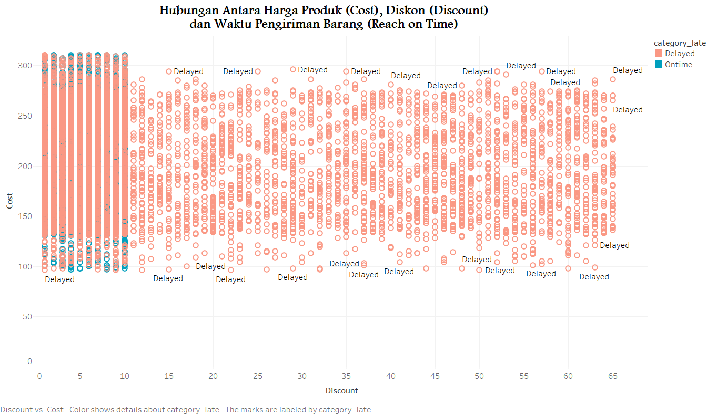
RELATIONSHIP BETWEEN PRODUCT PRICE, DISCOUNT AND TIMELINESS
Insight:
The relationship between discount, product price, and delivery does not show a clear pattern. Although the product has a high discount, on-time delivery must be guaranteed with effective logistics planning to ensure customer satisfaction.
Notes:
There is no particular trend between discounts and product prices: From the observation, there is no clear pattern between the product price and the amount of discount given. That is, a large or small discount does not necessarily mean that the product price will be low or high, and vice versa.
Shipping Priority for Products with Low or No Discount: When companies have limited resources or delivery capacity, they tend to prioritize deliveries for products with low or no discounts. This may be because products with high discounts require more resources or longer delivery times.

Slide 14
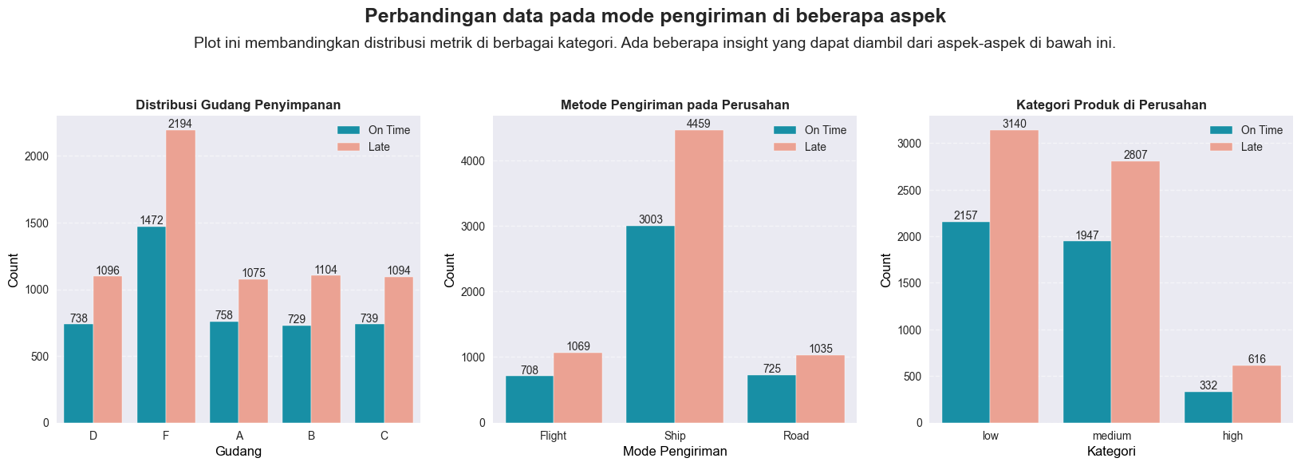
COMPARISON OF DATA ON DELIVERY MODES IN SEVERAL ASPECTS
Ontime
Delayed
Ontime
Delayed
Ontime
Delayed
2.500
5.000
4.000
2.000
4.000
3.000
1.500
3.000
2.000
1.000
2.000
1.000
1.000
500
0
0
0
A
B
C
D
F
Flight
Ship
Road
Low
Medium
High

Slide 15
COMPARISON OF DATA ON DELIVERY MODES IN SEVERAL ASPECTS
Ontime
Delayed
2.500
2.000
1.500
1.000
Insight:
Block F has the highest number of distributed products, but also has a high late delivery rate of 2194 cases.
500
0
A
B
C
D
F
Notes:
Warehouse
A
D: 1.075
O: 758
B
D: 1.104
O: 729
C
D: 1.094
O: 739
D
D: 1.096
O: 738
F
D: 2.194
O: 1.472

Slide 16
COMPARISON OF DATA ON DELIVERY MODES IN SEVERAL ASPECTS
Ontime
Delayed
5.000
4.000
Insight:
Ship has the highest number of shipments, but sea shipments have a higher percentage of delays with 4459 cases.
3.000
2.000
1.000
0
Flight
Ship
Road
Notes:
Shipment
Flight
D: 1.069
O: 708
Ship
D: 4.495
O: 3.003
Road
D: 1.035
O: 752

Slide 17
COMPARISON OF DATA ON DELIVERY MODES IN SEVERAL ASPECTS
Ontime
Delayed
4.000
3.000
Insight:
The majority of products with a low level of importance experienced 3140 delivery delays, while the delay rate for medium and high products was 3423.
2.000
1.000
0
Low
Medium
High
Notes:
Importance:
Low
D: 3.140
O: 2.157
Medium
D: 2.807
O: 1.947
High
D: 616
O: 332

Slide 18
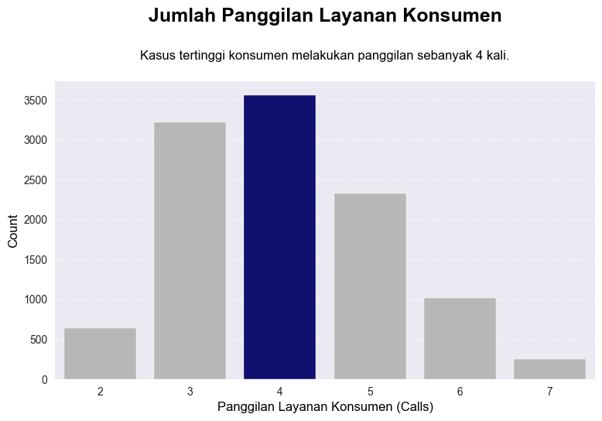

Number of Consumer Service Calls
Insight:
The graph shows that consumers often call back 4 times, showing the importance of improving customer service to provide faster and more accurate solutions.

Slide 19

Summary
Consumer assessment of the company is quite low.
The company needs to improve delivery efficiency, service quality, and warehouse management.
Focus on factors that affect consumer judgment and improve satisfaction.

Slide 20

Recommendation
Improve on-time delivery with route optimization and inventory management.
Improve customer service quality to solve problems in one call.
Evaluate the relationship between discounts and delivery time to improve customer satisfaction.

Slide 21


THANK
YOU!

